Slide 1
Machine Learning for data science and business intelligence – 8IAR403
By Kévin Bouchard Ph.D.
Professor in artificial intelligence & machine learning
Laboratoire d'Intelligence Ambiante pour la reconnaissance d'activités (LIARA)
Université du Québec à Chicoutimi
www.Kevin-Bouchard.ca

Slide 2
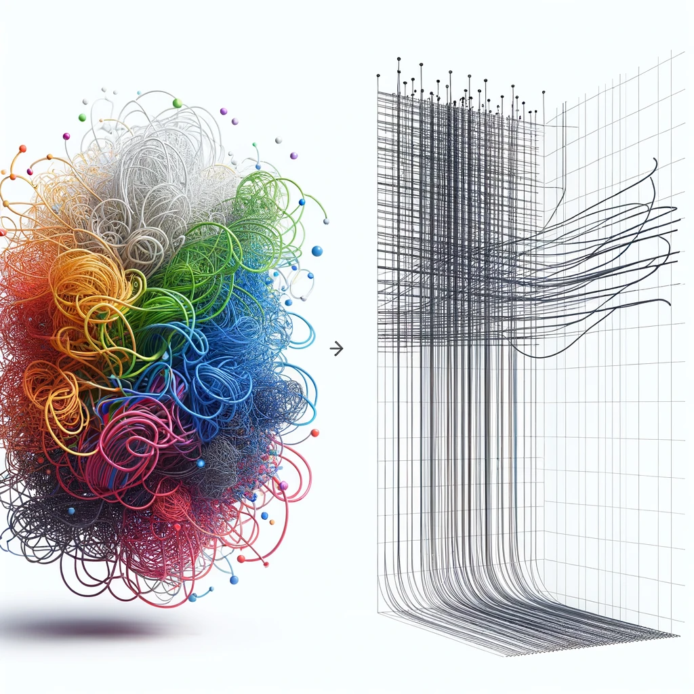
Summary of lesson #15
You will learn about:
The importance of feature selection in machine learning and data processing
Basic methods for feature selection
About Select K Best and the statistical measures needed to use it
Principal Component Analysis
Other methods and their main idea

Slide 3
Dimensionality
Dimensionality reduction is a set of techniques used in data processing and analysis to reduce the number of variables under consideration, or the dimensionality of the data set.
It is usually unsupervised, but some techniques take
advantage of available labels.
This is achieved while retaining as much meaningful and important information as possible.
Notes:
The PCA algorithm can be used to linearly transform the data while both reducing the dimensionality and preserve most of the explained variance at the same time.

Slide 4
Dimensionality Reduction
It can improve model performance by:
Reducing noise: By removing irrelevant or less significant features, feature selection helps in reducing the noise in the training data
Improving interpretability: Fewer features can make the model simpler and more interpretable (not always)
Reduce overfitting by:
Simplifying model: A model with fewer features is less complex and less likely to fit the random fluctuations in the training data that do not apply to the general population
Balancing better: It helps in balancing the proportion between the number of features and the number of observations, which is essential in training stable models
Decrease computational costs by:
Training Efficiency: Models with fewer features require less computation for training
Inference Speed: Models with fewer features are also faster at inference, which is critical for applications that require real-time predictions

Slide 5
Dimensionality Reduction
Remember we’ve talked about the curse of dimensionality
High-dimensional spaces often require exponentially more data to ensure that there are enough samples to populate the space
For example, in text classification tasks, the dataset might initially include a vast number of features
Especially if each unique word is treated as a feature; dimensionality potentially bigger than 10000-50000 depending on the language
Feature selection can reduce the feature space to include only the most informative words
Thus, improving the model's ability to differentiate between classes without requiring an unfeasibly large amount of training data

Slide 6
Dimensionality Reduction
By removing redundant features, feature selection can mitigate the effects of multicollinearity
It refers to the phenomenon in which two or more predictor variables are highly correlated
Meaning that one can be linearly predicted from the others with a substantial degree of accuracy
Multicollinearity can affect certain models by making the model training unstable and the interpretation difficult
For example, when predicting house prices, features such as square footage and the number of rooms may be highly correlated
Feature selection can help identify and remove redundant features

Slide 7
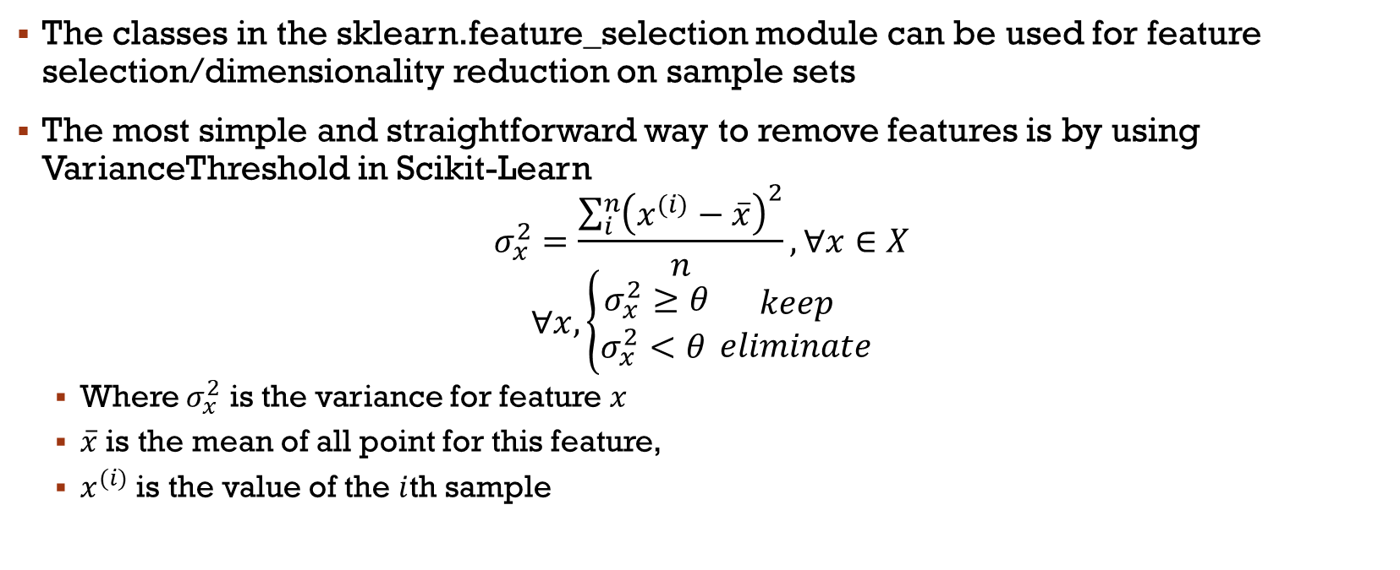
Basic methods
The classes in the sklearn.feature_selection module can be used for feature selection/dimensionality reduction on sample sets
The most simple and straightforward way to remove features is by using VarianceThreshold in Scikit-Learn
$$σ_{x}^{2}=\frac{\sum_{i}^{n}{{\left(x^{(i)}−\overline{x}\right)}^{2}}}{n}, ∀x∈X$$
$$∀x, \left\{\begin{matrix}σ_{x}^{2}≥θ \\ σ_{x}^{2}<θ \end{matrix}\right.\begin{matrix}keep \\ eliminate\end{matrix}$$
Where $σ_{x}^{2}$ is the variance for feature $x$
$\overline{x}$ is the mean of all point for this feature,
$x^{(i)}$ is the value of the $i$th sample

Slide 8
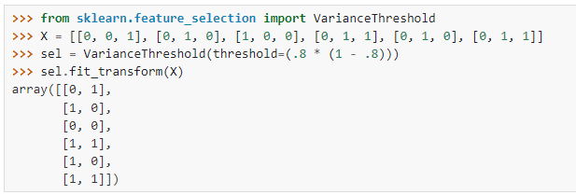

Variance threshold
The core idea behind Variance Threshold is to eliminate features that have low variance, under the assumption that features which do not vary much within the dataset are less informative or less discriminative
In this example, the feature with less than 0.8*(1-0.8)=0.16 variance is eliminated
$\overline{x}=1/6$, $σ_{x}^{2}=\frac{\left({5\left(0−\frac{1}{6}\right)}^{2}+{\left(1−\frac{1}{6}\right) }^{2}\right)}{6}≈0.1388$

Slide 9
Select K Best features
Select K Best ranks all the features based on certain criteria (like statistical tests) and selects the top K features
The value K is a user-defined parameter representing the number of features to select
In practice, it is often used in conjunction with other feature selection techniques or as part of a feature selection pipeline
Scikit-Learn also offer other similar methods such as SelectPercentile
It basically only switch k parameter by a percentile configuration

Slide 10
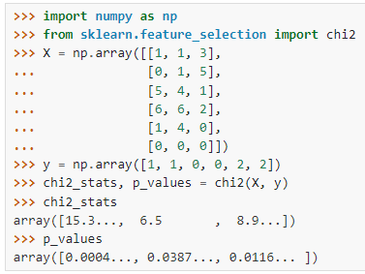
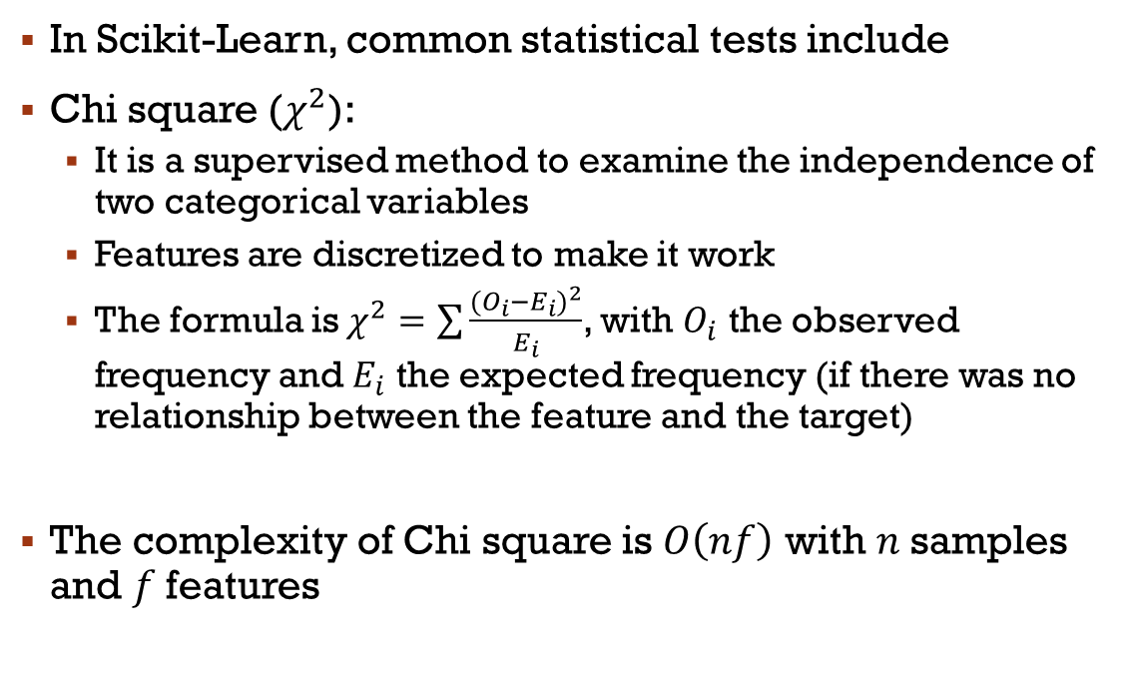
Select K Best features
In Scikit-Learn, common statistical tests include
Chi square ($χ^{2}$):
It is a supervised method to examine the independence of two categorical variables
Features are discretized to make it work
The formula is$χ^{2}=\sum{\frac{{(O_{i}−E_{i})}^{2}}{E_{i}}}$, with $O_{i}$ the observed frequency and $E_{i}$ the expected frequency (if there was no relationship between the feature and the target)
The complexity of Chi square is $O\left(nf\right)$ with $n$samples and $f$features

Slide 11
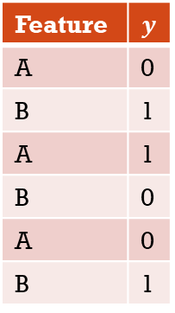
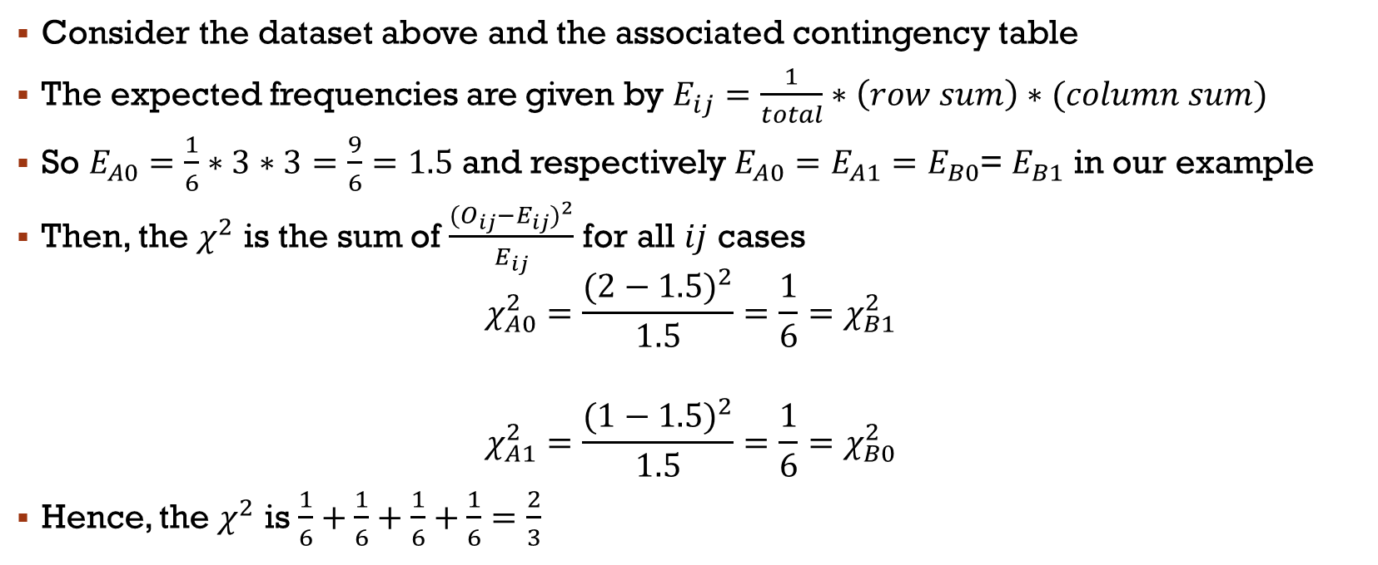
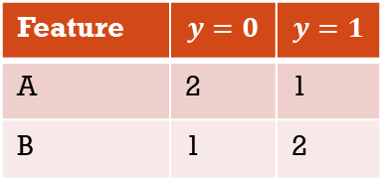
Chi squared example
Feature | $$y$$
A | 0
B | 1
A | 1
B | 0
A | 0
B | 1
Feature | $$y=0$$ | $$y=1$$
A | 2 | 1
B | 1 | 2
Consider the dataset above and the associated contingency table
The expected frequencies are given by $E_{ij}=\frac{1}{total}∗\left(row sum\right)∗(column sum)$
So $E_{A0}=\frac{1}{6}∗3∗3=\frac{9}{6}=1.5$ and respectively $E_{A0}=E_{A1}=E_{B0}$= $E_{B1}$ in our example
Then, the $χ^{2}$ is the sum of $\frac{{(O_{ij}−E_{ij})}^{2}}{E_{ij}}$ for all $ij$ cases
$$χ_{A0}^{2}=\frac{{(2−1.5)}^{2}}{1.5}=\frac{1}{6}=χ_{B1}^{2}$$
$$χ_{A1}^{2}=\frac{{(1−1.5)}^{2}}{1.5}=\frac{1}{6}=χ_{B0}^{2}$$
Hence, the $χ^{2}$ is $\frac{1}{6}+\frac{1}{6}+\frac{1}{6}+\frac{1}{6}=\frac{2}{3}$

Slide 12
Select K Best features
For classification, Scikit-Learn suggest using the Chi squared (chi2), ANOVA F-value (f_classif), or Mutual information (mutual_info_classif)
All three are supervised statistical measures
ANOVA f-value decomposes the variance in the data into components attributable to various sources
The F-value in ANOVA measures how much a feature contributes to the variance in the target variable
Assumes that the features are linearly related to the target
Sensitive to non-normal distributions and outliers
Mutual information measure of the dependency between the variables using entropy (similarly to Information Gain with decision trees)
It is non-negative and equals zero if and only if the variables are independent
Estimating mutual information accurately can be difficult for high-dimensional datasets

Slide 13
Principal Component Analysis
An algorithm with history, discovered in 1901 but still very much in use!
It is a statistical procedure that uses an orthogonal transformation to convert a set of observations of possibly correlated variables into a set of values of linearly uncorrelated variables called principal components
The principal hyperparameter is n_components to specify the dimensionality
For large datasets, one can use IncrementalPCA (and partial_fit)
Notes:
The PCA algorithm can be used to linearly transform the data while both reducing the dimensionality and preserve most of the explained variance at the same time.
Large dataset means = bigger than memory

Slide 14
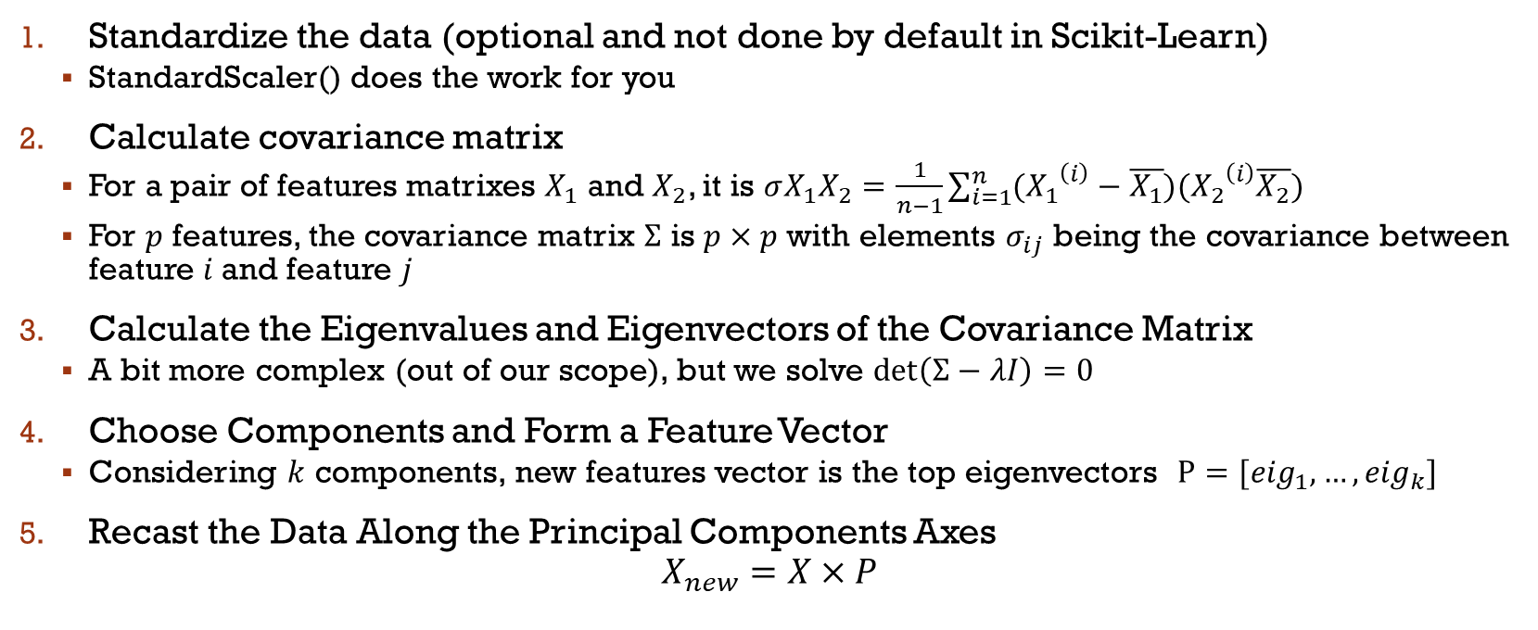
Principal Component Analysis
Standardize the data (optional and not done by default in Scikit-Learn)
StandardScaler() does the work for you
Calculate covariance matrix
For a pair of features matrixes $X_{1}$ and $X_{2}$, it is $σX_{1}X_{2}=\frac{1}{n−1}\sum_{i=1}^{n}{({X_{1}}^{\left(i\right)}−\overline{X_{1}})({X_{2}}^{\left(i\right)}\overline{X_{2}})}$
For $p$ features, the covariance matrix $Σ$ is $p×p$ with elements $σ_{ij}$ being the covariance between feature $i$and feature $j$
Calculate the Eigenvalues and Eigenvectors of the Covariance Matrix
A bit more complex (out of our scope), but we solve $\det\left(Σ−λI\right)=0$
Choose Components and Form a Feature Vector
Considering $k$ components, new features vector is the top eigenvectors $P=[{eig}_{1},…,{eig}_{k}]$
Recast the Data Along the Principal Components Axes
$$X_{new}=X×P$$
Notes:
Tell them we don’t go into details here

Slide 15

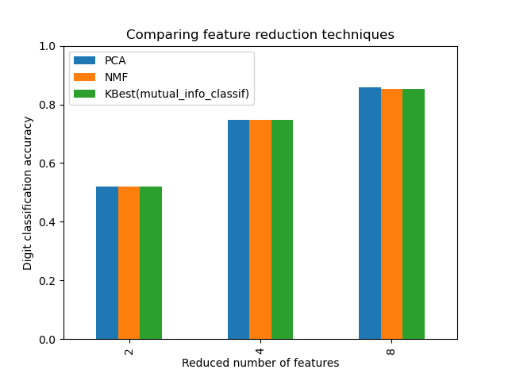

Comparing dimentionality reduction
Here is yet another great example on the Scikit-Learn documentation
It shows Kbest using infogain, PCA, and Non-Negative Matrix Factorization (see Scikit-Learn to know more)
All perform pretty similarly!
https://scikit-learn.org/stable/auto_examples/compose/plot_compare_reduction.html#sphx-glr-auto-examples-compose-plot-compare-reduction-py

Slide 16
Other common methods
Singular Value Decomposition
KernelPCA
Sparse PCA
MiniBatchSparse
Independent Component Analysis
Notes:
SparsePCA, les features sont toujours non-zero… peut être souhaitable… minibatch is faster but less precise
KernelPCA using kernel trick to do non-linear PCA (more expressive!)
SVD-factorisation d’une matrice (en trois) ->dire que c’Est complexe
ICA-moins pour réduire, plutôt pour séparer des signaux
https://scikit-learn.org/stable/auto_examples/decomposition/plot_pca_vs_lda.html#sphx-glr-auto-examples-decomposition-plot-pca-vs-lda-py

Slide 17
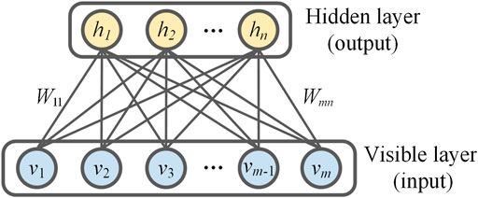
Using neural network?
In Scikit-Learn, offers a type of neural network called a Restricted Boltzmann Machine (RBM), in particular the Bernouilli type
They assume the inputs are binary or normalized between 0 and 1
They were first created in early 2000s by Hinton and Salakhutdinov
This Photo by Unknown Author is licensed under CC BY
Notes:
Ressemble a un autpoencodeur: The task of training is to minimize an error or reconstruction,
RBM: unite stochastic, task is to find how two sets of variable are correlated
RBM a aussi deux biais
Différent au niveau de l’entraînement

Slide 18
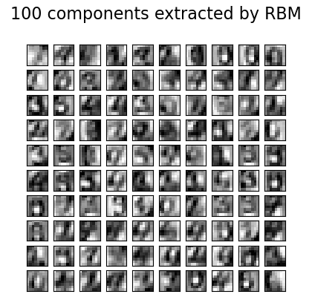
RBM
While there are different method to train RBMs, the most common is contrastive divergence
It is based on the gradient of the log-likelihood that we saw previously
They have been largely surpassed by other techniques like autoencoders and generative adversarial networks (GANs) in many applications
See the example from Scikit-Learn on digits classification:
https://scikit-learn.org/stable/auto_examples/neural_networks/plot_rbm_logistic_classification.html

Slide 19
Main References
Russell S., Norvig P., Artificial Intelligence: A Modern Approach. Prentice-Hall, Englewood Cliffs, 2021.
Aggarwal, C. C., Neural networks and deep learning. Springer, 2023.
Goodfellow I., Bengio Y., Deep Learning. The MIT Press, 2016.
Raschka S., Python Machine Learning, Packt Publishing, 2015.
Sutton R.S., Barto A.G., Reinforcement Learning: An Introduction, A Bradford Book, 2021.
Witten I.H., Frank E., Hall M.A., Pal C. Data Mining: Practical Machine Learning Tools and Techniques, Morgan Kaufmann, 2016.

